Slide 1
Nasdanika Foundation Server
v. 0.1.0
Domain-Centric Web development

Slide 2
Overview
A collection of OSGi/Equinox bundles/components for development of extensible multiuser Web applications with complex domain model and application logic.
A layer over EMF CDO
RESTful Object-Oriented polymorphic Web UI
Repository objects and their structural features are URL-addressable.
Fluent Java API for building HTML/Bootstrap UI and single-page applications.
Low TCO & short time-to-market.

Slide 3
Example 1 – Naked EObject
Reflective UI for navigating CDO repositories including package registry.

Slide 4
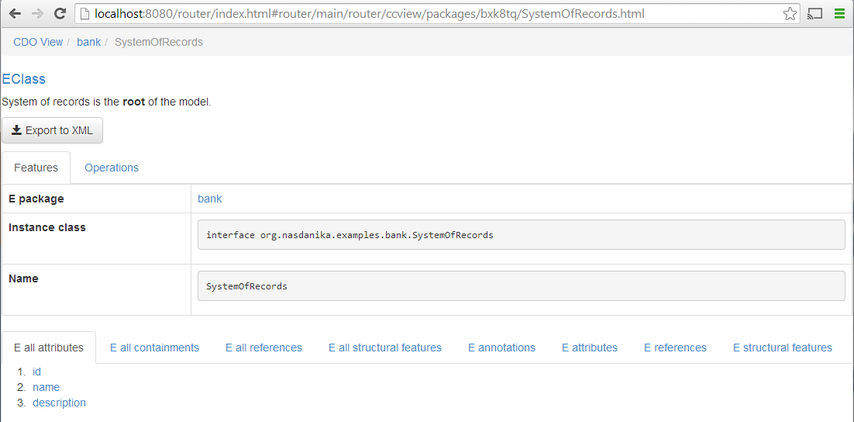
EClass SystemOfRecords
Single page application route
CDO View path
EClass in EPackage
Routing Servlet
Backbone route
bank package path
HTML extension route
Target HTML Element ID
This tab is Ajax-loaded from structural feature URL http://localhost:8080/router/ccview/packages/bxk8tq/SystemOfRecords/eAllAttributes.html

Slide 5
Example 2 – Polymorphic UI
Subclasses can override parts of UI

Slide 6
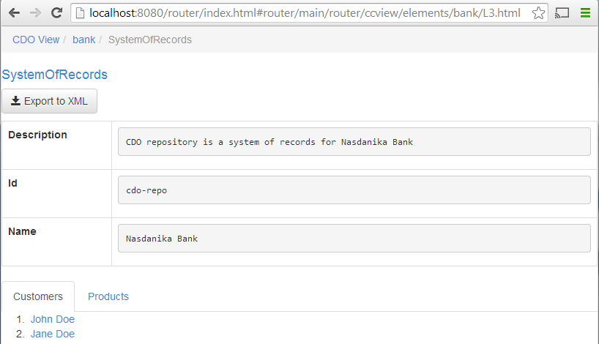
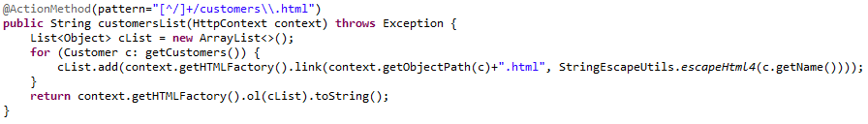
Feature route override
Resource in CDOView
CDOID
Overridden list of customers

Slide 7
Example 3 – Custom UI
Each customer has its own web application URL

Slide 8
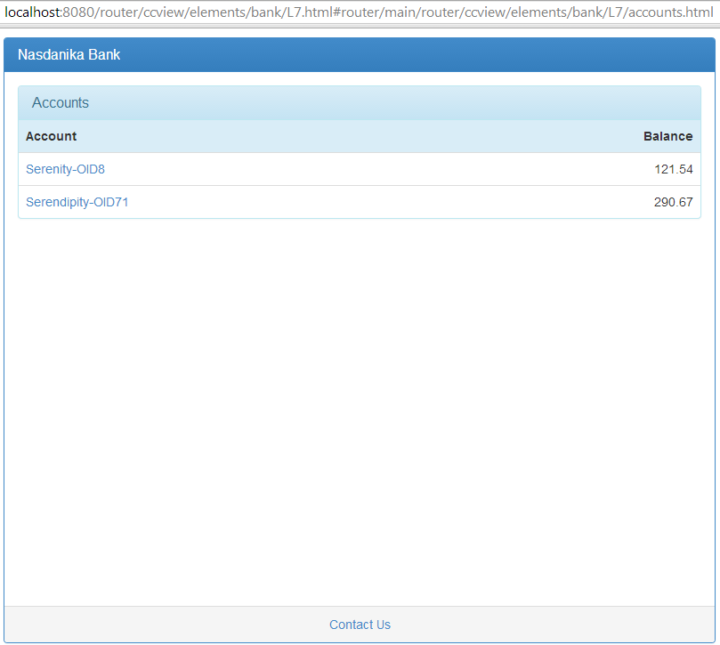
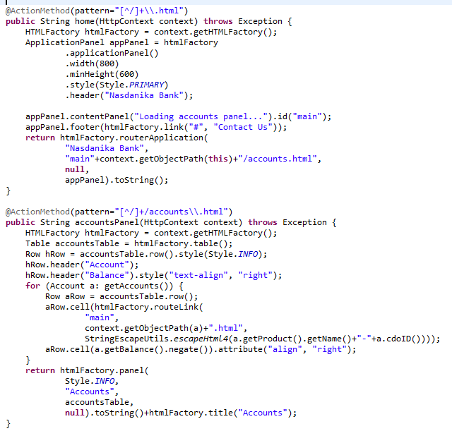
Customer SPA
Default UI rendering is overridden by action methods
Accounts panel is Ajax-loaded as initial route

Slide 9
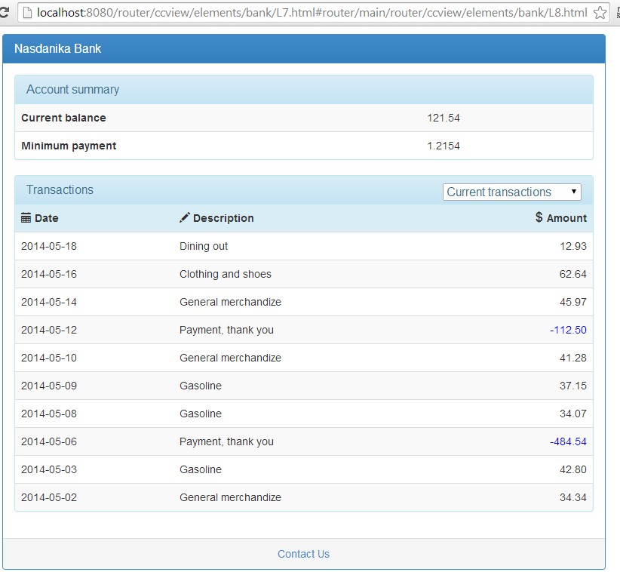
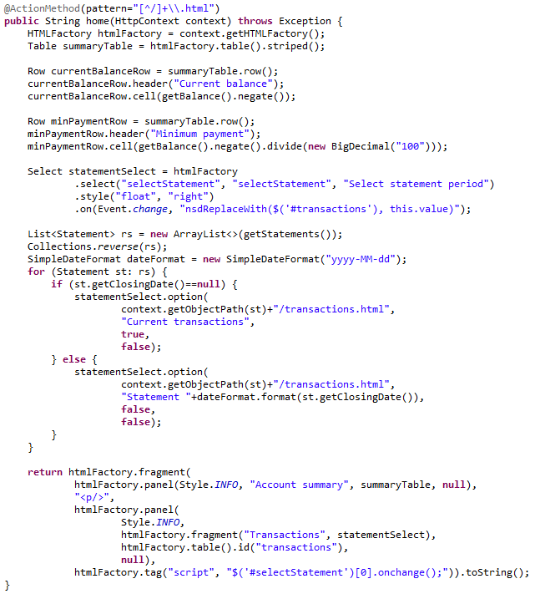
Account summary page
Transactions table is dynamically reloaded on transaction period selection.

Slide 10
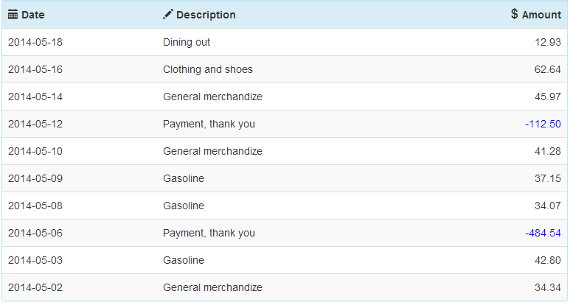
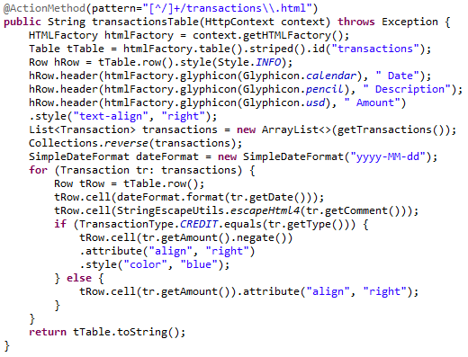
Transactions table

Slide 11
Architecture
Nasdanika components
Third-party components
org.nasdanika.examples.bank.app
org.nasdanika.examples.bank
org.nasdanika.cdo.security
org.nasdanika.flow
org.nasdanika.cdo.xa
Apache Felix Web Console
org.nasdanika.cdo, org.nasdanika.cdo.h2
org.nasdanika.transaction
org.nasdanika.web
EMF CDO
Atomikos Transaction
Essentials
Jetty
org.nasdanika.html
org.nasdanika.core
org.nasdanika.thirdparty
Apache Commons Lang
OSGi/Equinox
Java

Slide 12
Concepts
Contexts – Http, View, Transaction
Context merging
Commands execute in Contexts
Routes – root, object, extension, feature
Action methods
Converters
Object path resolvers

Slide 13
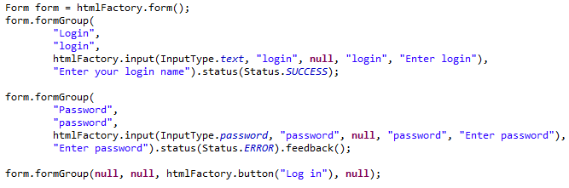
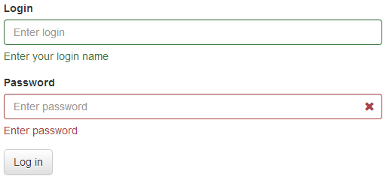
org.nasdanika.html
A fluent Java API for building Web UI
Low level – tag, div, attributes, styles.
High level – builders for 18 Bootstrap UI elements.
Example:
More details:
http://www.slideshare.net/PavelVlasov2/nasdanika-html-fluent-java-api-for-building-htmlbootstrap-web-ui

Slide 14





org.nasdanika.core
AuthorizationProvider
Context
TransactionContext
ContextProvider
Command
CommandExecutor
CommandExecutorComponent
Converter & ConverterContext
Annotations and classes for wrapping method into commands
Extension points for coverters and authorization providers

Slide 15
org.nasdanika.web
Routing servlet, routes, converters, …

Slide 16


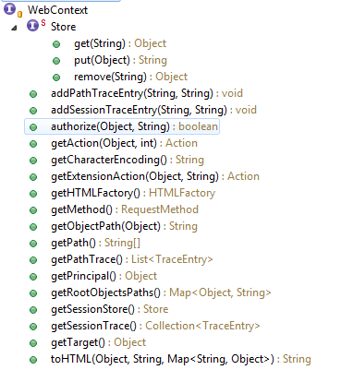

Contexts

Slide 17

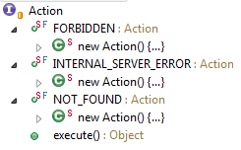
Routes
Root route
Entry point - matches request path
May resolve context object and pass processing to object routes
Object route – matches “tail” of request path in the context of a specific object type
Extension route – matches extension, e.g. html extension route for GET method renders context object to HTML.

Slide 18
Router servlet
Collects routes, converters, and object path resolvers from extensions and services
Creates HttpContext
Matches and invokes a root route

Slide 19

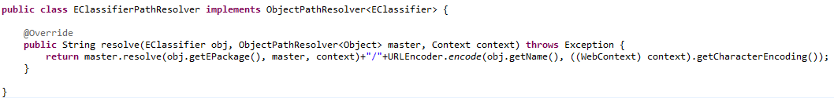
ObjectPathResolver
Resolves object path.
Invoked by WebContext.getObjectPath() method.
Which is used for constructing references.
Typically resolves path relative to container.

Slide 20
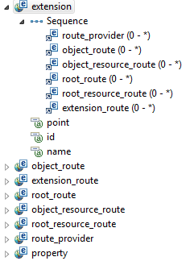
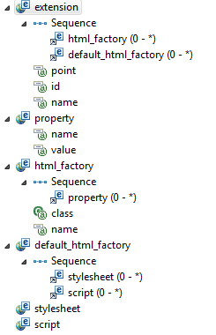
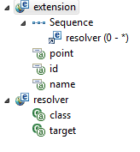
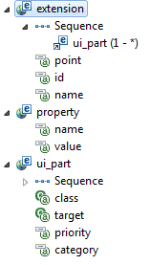
Extension Points
Route
HTML Factory
Object Path Converter
UI Part

Slide 21
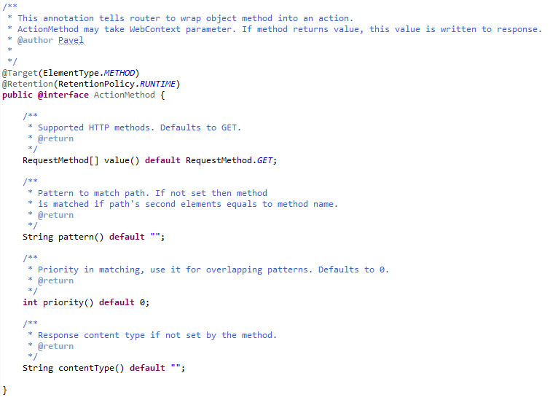
ActionMethod Annotation
Wraps methods into object routes.

Slide 22
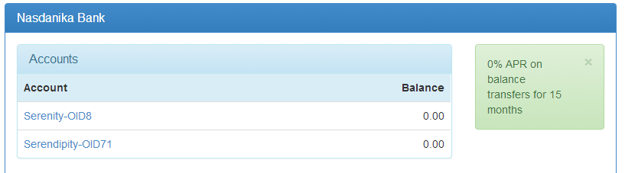
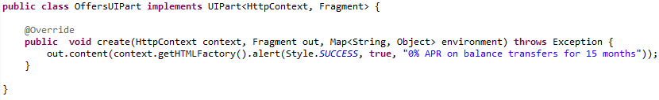
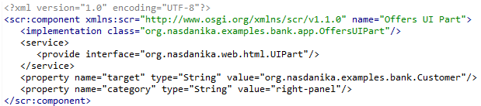
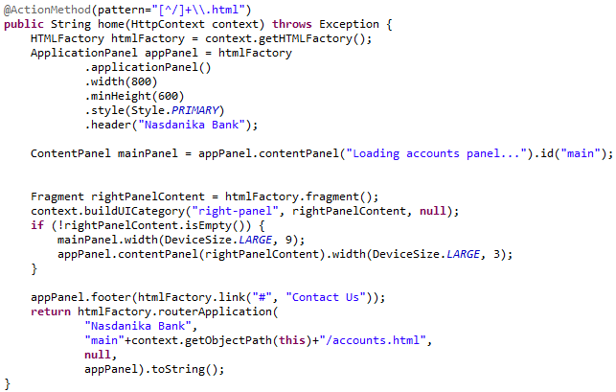
UI Part
The Whiteboard pattern for UI construction
UI parts implementations
OSGi service
Eclipse extension
Defined for a target class and category
Invoked through WebContext.buildUICategory

Slide 23
org.nasdanika.cdo
Classes, interfaces and components for working with CDO views and transactions and ECore classes

Slide 24
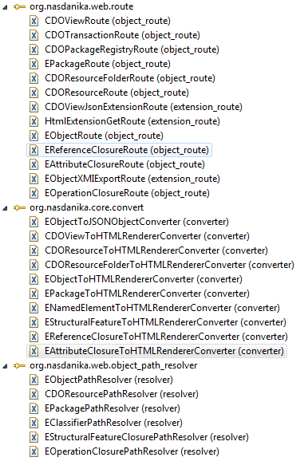
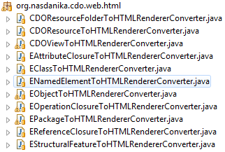
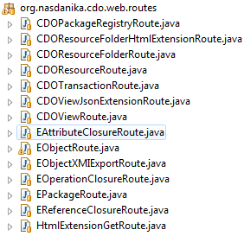
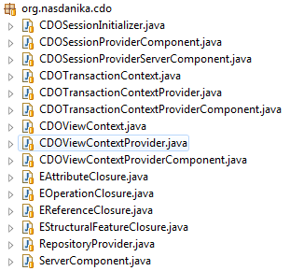
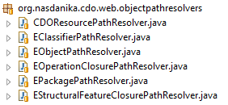
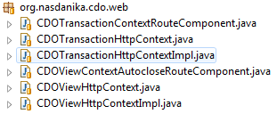
Overview

Slide 25
OSGi components
H2RepositoryProvider
CDOSessionProviderComponent
ServerComponent
CDOSessionProviderServerComponent
CDOTransactionContextProviderComponent
CDOViewContextProviderComponent
CDOTransactionContextRouteComponent
CDOViewContextAutocloseRouteComponent

Slide 26
Components wiring
Route component exposes Route service used by Routing servlet.
Route component depends on Context provider service exposed by the view context provider component.
View context provider uses session provider service.
Session provider component depends on repository provider service/component.

Slide 27
Summary
CDOViewContextAutocloseRouteComponent
Opens CDOView
Creates CDOViewContext
Merges CDOViewContext with HttpContext
Delegates processing to object routes
Object routes use converters to generate HTML
Converters use object path resolvers to construct object URL’s and Nasdanika HTML for building Web UI

Slide 28
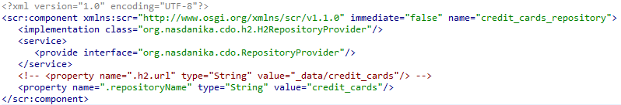
org.nasdanika.cdo.h2
Repository provider component for H2 database.
Sample component configuration:

Slide 29
Development process
“Dressing” an object

Slide 30
A metaphor*
Model structure is a skeleton
Classes, inheritance
Structural features – attributes and references
Operation signatures
Operations implementation (business logic) is muscles
EMF reflection is skin – it doesn’t expose all object internals as Java reflection does, but only those defined in the model.
User interface is a dress
* Inspired by Naked Objects (http://en.wikipedia.org/wiki/Naked_objects)

Slide 31
Bottom-up process
Create a model, document.
Deploy the model to the server
Model structure with documentation is exposed through reflective Web UI
Repository objects are exposed “naked” – they can be manipulated through reflective Web UI
Dress the model in a custom Web UI
Use this approach for well-defined domain models

Slide 32
Advantages
The model is exposed through the reflective Web UI upon deployment to the server.
Custom UI development can proceed in parallel with using the system through the reflective UI.
Reflective and custom Web UI can be used at the same time and intertwine.
Some systems may customize only part of UI, and some, e.g. short-lived situational applications, may do with just reflective UI

Slide 33
Top-down process (BDD)

Slide 34
Combined process
Create initial model and deploy to server
Use reflective UI as a conversation starter to elicit user stories from SME’s
Refine the model and the UI based on stories

Slide 35
Build & Deployment options
Internal deployment
Download and start server
Deploy bundles to the server through Web console
Packaged product
Use product definition with foundation and custom bundles
Build product from the definition

Slide 36
Façade objects
Model elements can façade external systems
In this case object data is used as configuration for connecting to external service
For example, an object may façade a web service and store connectivity data in its attributes, e.g. endpoint URL.

Slide 37
A federation of mini-apps
Because UI is bound to model elements, a system UI may be constructed as a federation of mini-applications
Role-specific application
Activity-specific application

Slide 38
Roadmap
v. 0.2.0 – Security
v. 0.3.0 – Enhancements in reflective UI
Support of PUT, POST, DELETE, PATCH methods
Operation invocation
Support of Feature/Operation level customizations
v. 0.4.0 – JSON extension routes
Example of AmurJS client-side flow
v. 0.5.0 – Server-side flow execution
v. 0.6.0 – XA – multi-repository and JTA transactions
v. 0.7.0 – JavaScript routes – dynamically generated JavaScript facades for repository objects.
v. x.x.x - XML routes, WebSocket

Slide 39
Nasdanika Bank
Sample application

Slide 40
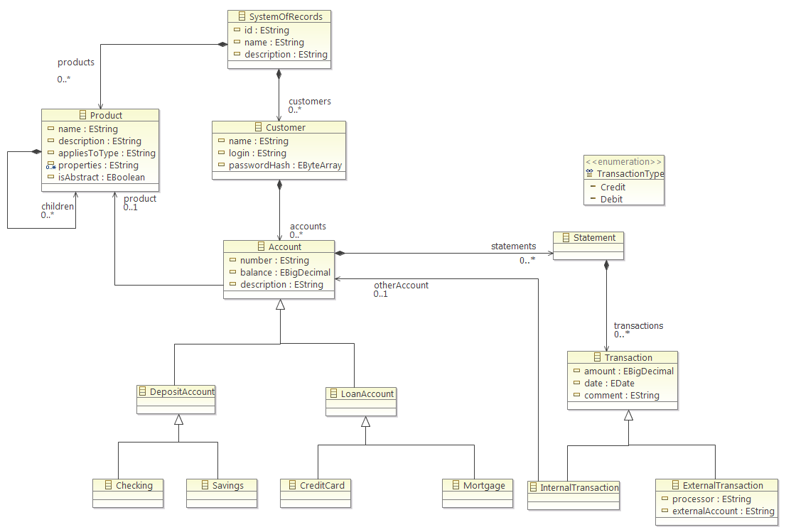
org.nasdanika.examples.bank
Contains sample bank model
Custom UI with action methods – see Example 3.

Slide 41
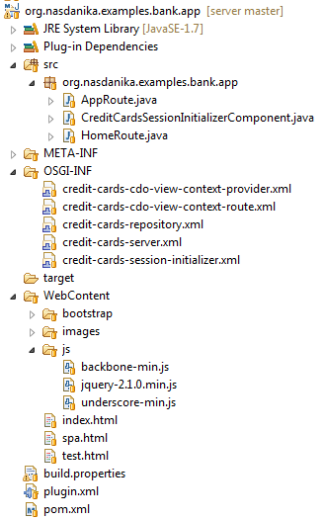
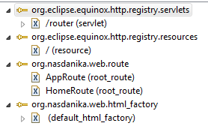
org.nasdanika.examples.bank.app

Slide 42
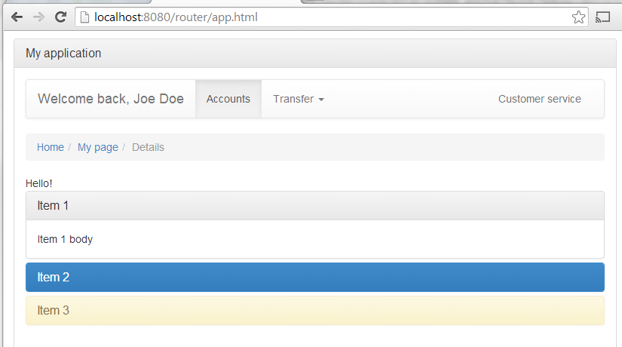
AppRoute.java
Demo of Nasdanika HTML

Slide 43
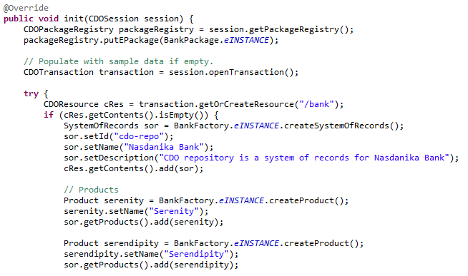
CreditCardsSessionInitializerComponent.java
Registers bank package
Populates bank repository with sample data, if the repository is empty

Slide 44
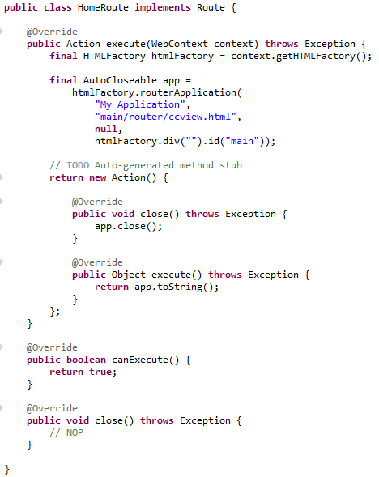
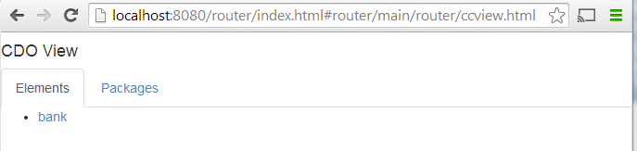
HomeRoute.java
Creates router application
Loads CDO View as initial route

Slide 45
References
Sources:
Master - https://github.com/Nasdanika/server
Release 0.1.0 - https://github.com/Nasdanika/server/releases/tag/server-0.1.0
P2 repository - http://www.nasdanika.org/repository
Binary distributions
Foundation server
Windows 64 - http://www.nasdanika.org/products/org.nasdanika.server-win32.win32.x86_64.zip
Linux GTK x86 64 - http://www.nasdanika.org/products/org.nasdanika.server-linux.gtk.x86_64.zip
Foundation server with examples
Windows 64 - http://www.nasdanika.org/products/org.nasdanika.examples-win32.win32.x86_64.zip
Linux GTK x86 64 - http://www.nasdanika.org/products/org.nasdanika.examples-linux.gtk.x86_64.zip
Nasdanika HTML presentation - http://www.slideshare.net/PavelVlasov2/nasdanika-html-fluent-java-api-for-building-htmlbootstrap-web-ui

